Slide 1

THE ONE-STOP TRAVEL BOOKING PLATFROM CSA4309:INTERNET PROGRAMMING FOR WEB SERVICES
Project Supervisor
Dr. Jayasakthi Velmurugan K
Department of Deep Learning
Saveetha School of Engineering,
SIMATS
Presented By
S. Shashank- 192210222
T. Nithin babu- 192211114
L. Lava kumar- 192211006
Saveetha School of Engineering,
SIMATS

Slide 2

Introduction
1
Comprehensive Travel Solutions
2
Personalized Recommendations
Our platform offers travel services for flights, trains, and buses. TRAVELBUDDY.com makes it easy to plan and book trips using different types of transport all in one place.
Tailored suggestions based on your preferences and travel history ensure a seamless and customized experience.
3
Intuitive User Interface
Our user-friendly design simplifies the booking process, providing a smooth and efficient experience.

Slide 3


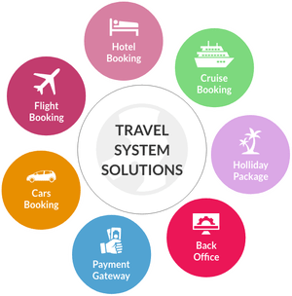
Aim & Objectives
Streamline Travel Planning
Enhance User Experience
Increase Efficiency
TRAVELBUDDY.com makes planning trips simple by allowing users to book flights, trains, and buses all in one place, quickly and easily.
Offer personalized suggestions and an intuitive interface to make travel planning a breeze.
Our platform saves users time by offering a fast and convenient way to book flights, trains, and buses all in one place.

Slide 4

Existing System & Drawbacks
1
Fragmented Platforms
Travelers often have to navigate through multiple websites to book different aspects of their trip.
2
Lack of Personalization
Existing systems often fail to provide tailored recommendations based on user preferences and travel history.
3
Time-Consuming Booking
The manual process of searching, comparing, and booking various travel components can be time-consuming and frustrating.

Slide 5
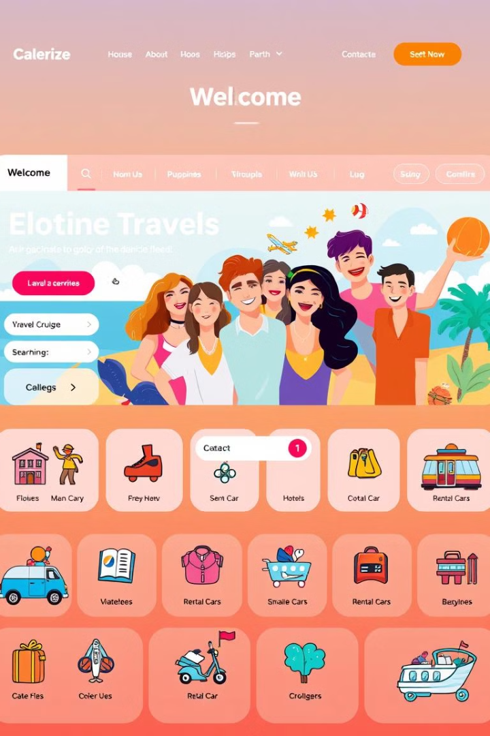
Proposed System
Integrated Booking
Personalized Recommendations
Our platform consolidates flight, hotel, and transportation bookings in a single, user-friendly interface.
Leveraging AI and machine learning, we provide tailored suggestions based on your preferences and travel history.
Seamless Experience
One-Stop Solution
Our intuitive design and automated processes streamline the entire travel planning and booking journey.
From flight booking to accommodation and local experiences, our platform is your comprehensive travel companion.

Slide 6



Block Diagram
Flight Booking
Transportation
Trip Planning
Arrange, airport transfers, and local transportation for a complete travel experience.
Seamlessly book flights from a wide range of airlines and destinations.
.
Discover and book local activities, tours, and experiences to enhance your journey.

Slide 7






Techniques Used
AI-Powered
Machine Learning
HTML
Leveraging artificial intelligence to provide personalized recommendations and optimize the booking process.
Utilizing advanced algorithms to analyze user data and behaviors, enabling personalized suggestions.
The backbone of web pages, structuring content with
elements like headings, paragraphs, links, and images.
:
Cloud-Based
Data-Driven
Deploying our platform on a scalable and secure cloud infrastructure for optimal performance and availability.
Harnessing real-time data insights to continuously improve the user experience and enhance our offerings.
PHP
server-side scripting language used to create dynamic web pages and interact with databases.

Slide 8

Modules
Flight Booking
Comprehensive search and booking capabilities for flights across multiple airlines.
Transportation
Seamless booking of car rentals, airport transfers, and local transportation options.
Discover and book local experiences, tours, and activities to enrich your travel journey.
Trip Planning

Slide 9
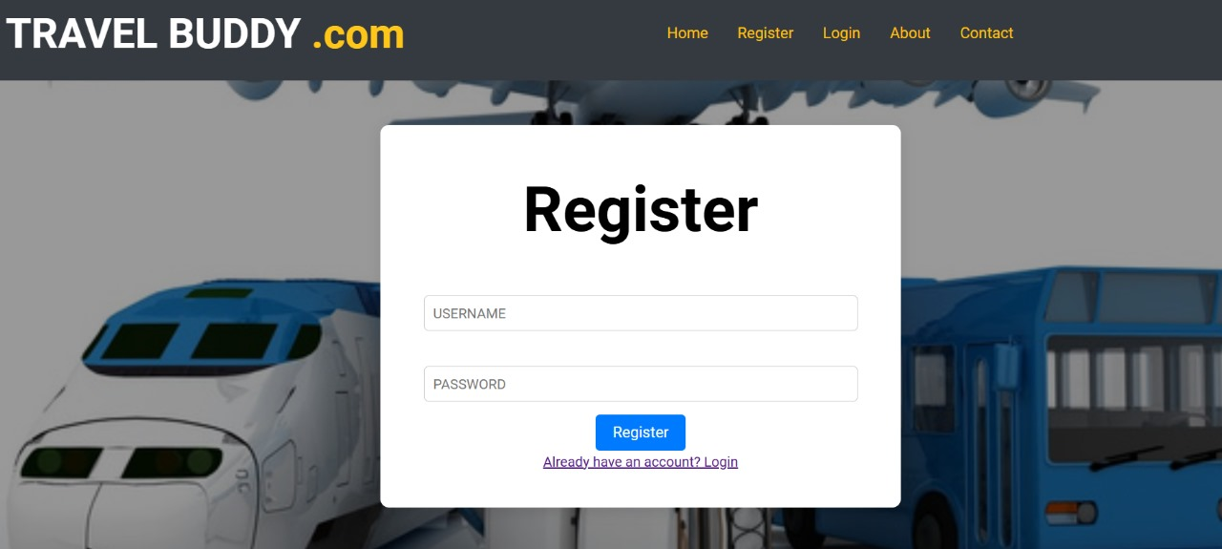

Slide 10
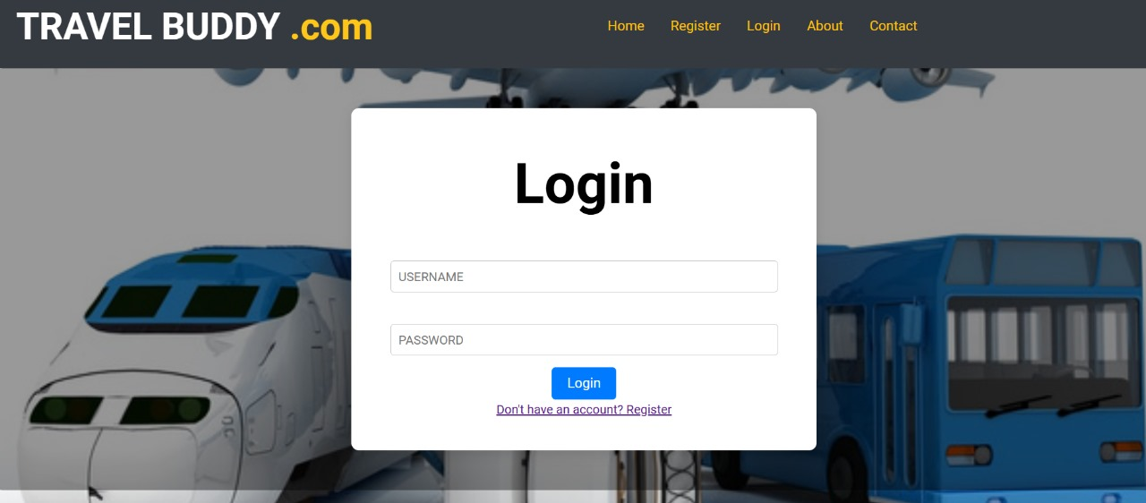

Slide 11
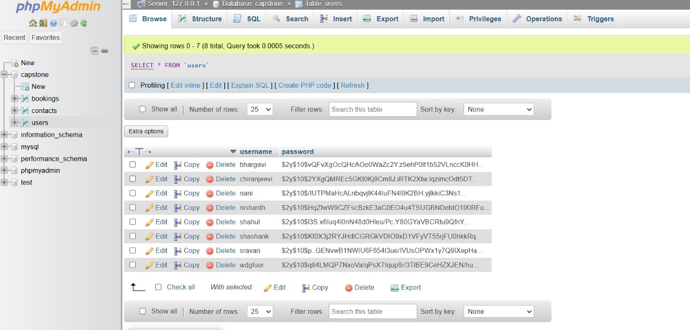

Slide 12
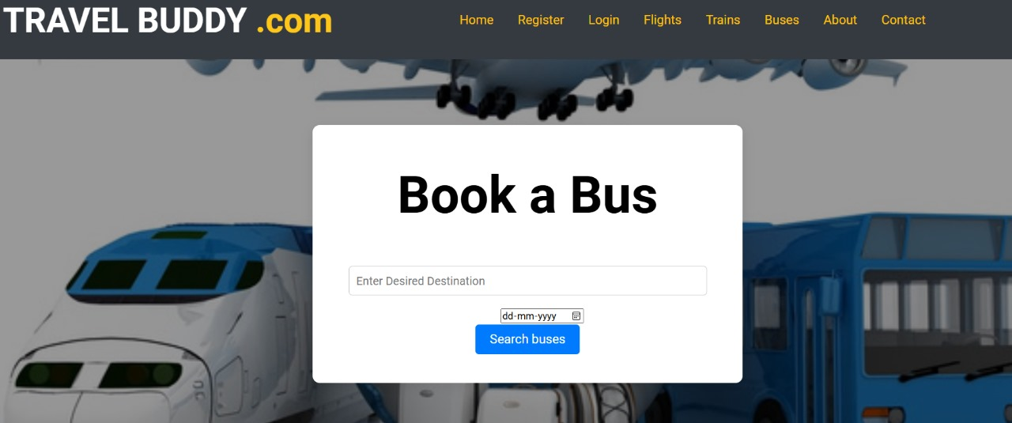

Slide 13




Conclusion & Future Enhancements
Comprehensive Travel Solutions
Our platform streamlines the entire travel booking process, from flights to accommodations and beyond.
Personalized Experiences
Leveraging advanced technologies, we provide tailored recommendations to enhance your travel journey.
Continuous Improvement
We're committed to regularly updating and enhancing our platform to meet the evolving needs of our users.

Slide 14


